Slide 1


Directions
In the chat, please include your name, email, position, and school name.
Something to think about…
How does your role intersect with the Zones of Choice?
.
What questions and concerns might you have regarding the Zones of Choice?
Important Note
This meeting is being recorded.

Slide 2

Zones of Choice Overview
2024-2025
.
September 25, 2024

Slide 3
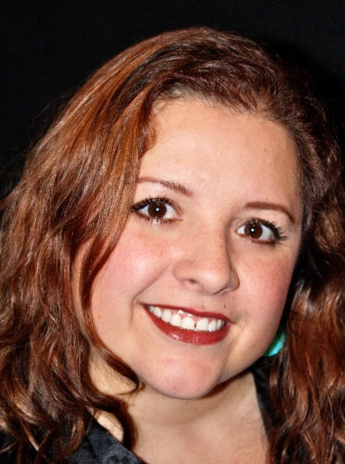
Welcome!
Dunia Fernandez
PPDA
Zones of Choice
Strategic Enrollment & Program Planning Office
dunia.fernandez@lausd.net | (213) 241-0466

Slide 4
Introductions
Background
Timeline
Policy and Procedures
Reference Guides
Q & A
Agenda

Slide 5
Zones of Choice Team
  Dunia Fernandez –PPDA
  Joy Muraoka– Administrative Assistant
  Angelica Cabrera – ZOC Facilitator
  Rosalinda Vazquez – ZOC Facilitator
  Sabrina Huizar – ZOC Facilitator
  Vacancy – ZOC Facilitator
  Elias Higham – Admin Aide
  Guest:
  - Jesus Oliden - Special Ed. Service Center Operations
ZONES OF CHOICE

Slide 6
Angelica Cabrera
  Belmont ZOC
    Belmont HS, Contreras LC, Cortines VAPA, Roybal LC
  Bernstein ZOC
  Carson ZOC
  Huntington Park
    Huntington Park HS, Marquez HS
  Narbonne ZOC
  Northeast ZOC
    Lincoln HS, Wilson HS
FACILITATOR ASSIGNMENTS

Slide 7
Rosalinda Vazquez
  Boyle Heights ZOC
    Mendez HS, Roosevelt HS
  Eastside ZOC
    Garfield HS, Boyle Heights Hilda Solis HS, Torres HS
  Fremont ZOC
    Dymally HS, Fremont HS, Rivera LC
  South Gate MS ZOC
    International LC, Southeast MS, South Gate MS
FACILITATOR ASSIGNMENTS

Slide 8
Sabrina Huizar
  Bell ZOC
    Bell HS, Elizabeth LC, Legacy HS, Maywood Academy
  Jefferson ZOC
    Angelou CS, Jefferson HS, Santee EC
  North Valley ZOC
    Chavez LA, San Fernando HS, Sylmar Charter HS
  Northwest ZOC
    Northridge Academy, Valley Academy of Arts & Sciences
  RFK ZOC
  San Fernando Area MS ZOC
  South Gate ZOC
    Legacy HS, South East HS, South Gate HS
FACILITATOR ASSIGNMENTS

Slide 9
WHY THE ZONES OF CHOICE?
January 10, 2012: The School Board passes the Resolution on Expanding Enrollment and Equal Access through LAUSD Choice (Expands overall district enrollment at least 5% over three years.)
January 17, 2012: The School Board passes the Resolution to Examine Increasing Choice and Removing Boundaries for Neighborhood Schools. (Examines the potential impact on equity and quality of schools by transitioning to a full choice school system.)
Office of School Choice: Parents have more choices and the ability to easily access their school options.

Slide 10
WHAT ARE THE ZONES OF CHOICE?
Geographic areas comprised of multiple school options.
Offer exciting programs in the arts, business, science, humanities, social justice and more right in your neighborhood.
School options include, large campuses, small learning communities, academies, and more.

Slide 11
HOW DOES IT WORK?
Students residing in a Zone of Choice are eligible to attend any school in the Zone.
No home school – home zone.
Students select and rank the schools within their residential area.
For SY 2024-2025 there are 17 Zones of Choice with 98 school options.

Slide 12
TWO OPTIONS TO APPLY *
Students will complete the application online at their current middle school site (only current 8th graders.)
Parents can submit an online application from October 1 – November 15, 2024 (current 8th graders, 5th graders in South Gate MS ZOC and San Fernando Area MS ZOC, 5th and 6th graders in Montara ES.)
* Paper applications accepted after November 18th

Slide 13
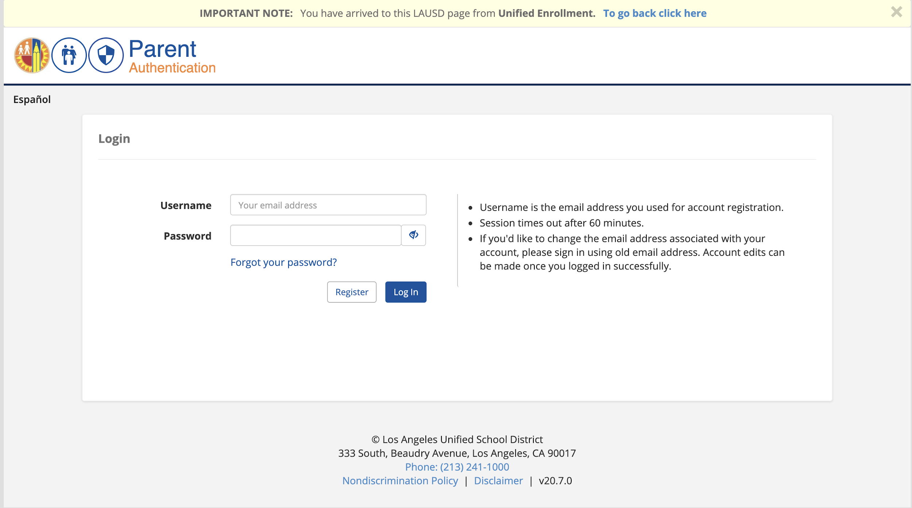
Parents: Online Application
When: October 1 – November 15, 2024
Where: Apply.LAUSD.net
Who: All current and new LAUSD students entering 9th grade and 6th grade
Help: (213) 241-0466

Slide 14
VIRTUAL PARENT ORIENTATIONS
  Tuesday, 10/01/24 @ 9:00am (ENG)
  Tuesday, 10/01/24 @ 4:00pm (ENG)
  Wednesday, 10/09/24 @ 9:00am (ENG)
  Wednesday, 10/09/24 @ 4:00pm (ENG)
  Wednesday, 10/02/24 @ 9:00am (SPAN)
  Wednesday, 10/02/24 @ 4:00pm (SPAN)
  Thursday, 10/10/24 @ 9:00am (SPAN)
  Thursday, 10/10/24 @ 4:00pm (SPAN)

Slide 15
PARENT ORIENTATIONS
Webinar ID and Link:
https://bit.ly/zocparentorientation
Webinar ID: 897 0896 5339
Passcode: 152681
Call: (213) 338-8477, 89708965339#

Slide 16
IN-PERSON PARENT ORIENTATIONS
  Virgil Middle School
  152 N Vermont Ave, Los Angeles, CA 90023
  Monday, October 14, 2024
  4:00 – 5:30 pm
  Stevenson Middle School
  725 S Indiana St, Los Angeles, CA 90004
  Tuesday, October 15, 2024
  8:30 – 10:00 am
  Fremont High School
  7676 S San Pedro St, Los Angeles, CA 90003
  Wednesday, October 16, 2024
  4:30 – 6:00 pm

Slide 17

POLICY & PROCEDURES
ZOC School Applications
  Online – Apply.LAUSD.net
  Paper – LAUSD.org/zoc email to zoc@lausd.net or Fax: (213) 241-4108
  Check residential address
  Do not provide parents information regarding space in your school
  Only enroll students that are on your ZOC student roster, not MISIS
ZOC School Brochure
  Prepare updates and edits
  Submit all changes to ZOC
  Review published version
ZOC School Videos
  Submit new videos or provide instructions if keeping old video online

Slide 18
POLICY & PROCEDURES
Family Outreach
Parent Outreach
  Flyers
  Blackboard Connect calls and text messages
  Webinar Parent Orientations (English/Spanish)
Articulation Activities
  Elementary & Middle school invitations should include ALL high schools in the Zone, South Gate MS ZOC, and San Fernando Area MS ZOC
  Provide equal access and time to each school
  Ask ZOC team for coordination support
  Focus on school highlights, not on negative information
Notes:
Please refer to timeline

Slide 19
POLICY & PROCEDURES
Assignments
Current 5th & 8th Graders (6th graders in Montara ES)
  Articulation Lists
  Assignments are based on preference and space availability
  ECAST & Operational Capacity
Rounds of Assignments
  Five rounds from March-June
  Lists are cumulative
  Include students accepted into Choices programs (Magnet)

Slide 20
POLICY & PROCEDURES
Appeals & OTTs
Appeals
  Parent initiated
  Processed only by ZOC
  Based on hardships, siblings,and medical
  Accepted beyond application window
  None accepted after Norm Day
One-Time Transfer (OTT)
  Current 6-7th and 9-11th graders
  Schools should provide reasoning for non recommendation
  ZOC office retains discretion for approval/denial
  Student must be in good standing
  Cannot be used for safety concerns (Opportunity Transfer)
  Accepted beyond application window

Slide 21
POLICY & PROCEDURES
Permits
Intra-District Permits and Open Enrollment:
  Open Enrollment Permits/Intra-District Transfers are outside the purview of the ZOC office and should be granted at the discretion of the school principal following guidelines outlined in BUL-5606.1
  Open Enrollment Permits/Intra-District Transfers should NOT be used for students residing inside the Zone attendance boundaries.

Slide 22
POLICY & PROCEDURES
Specialized Support
EL & Newcomers
  MMED support
  SEPA Centers
Homelessness & Foster Care
  Reference Guide: BUL-6718.0
  Immediate enrollment
  ZOC follow up
Schools for Advanced Studies (SAS)
  Reference Guide: MEM-5974.3
SPED
  Reference Guide: REF-6047.1
  Transition IEP
  SPED division support

Slide 23
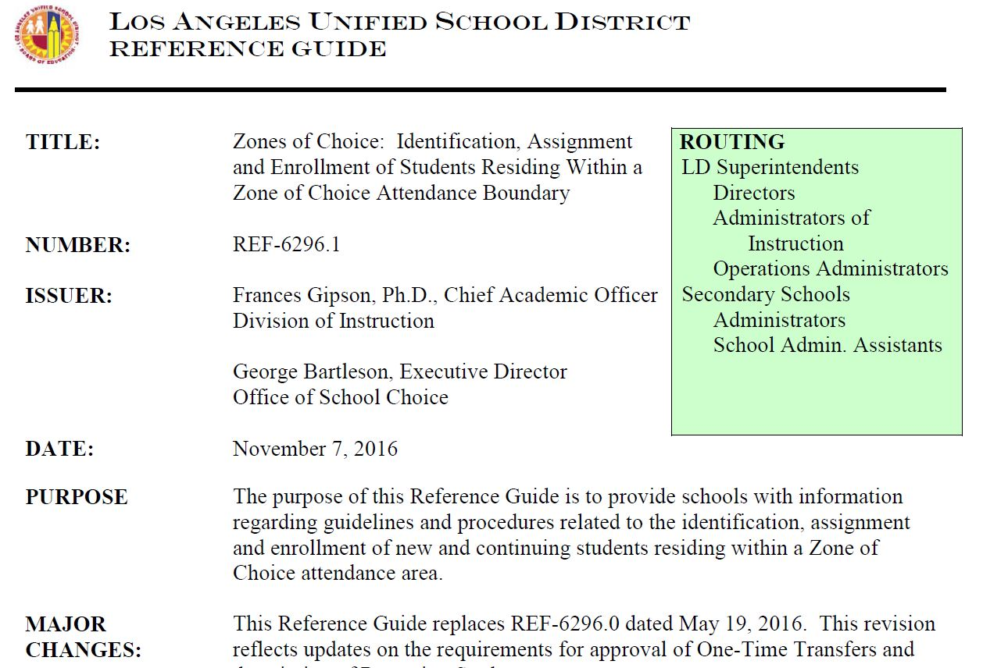
REFERENCE GUIDES
__________________________________________________________
ZOC Enrollment

Slide 24
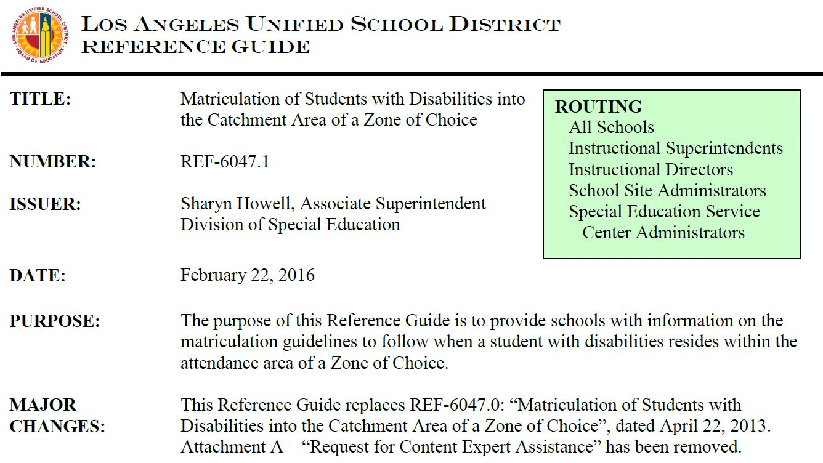
REFERENCE GUIDES
__________________________________________________________
ZOC Students with Disabilities

Slide 25
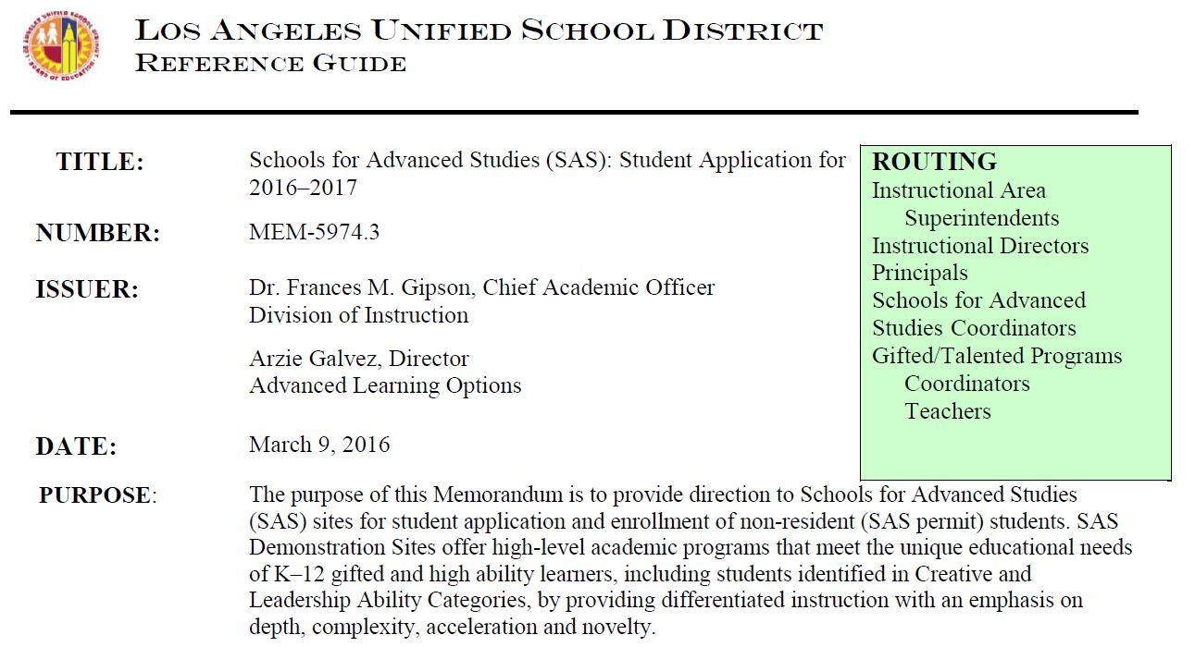
REFERENCE GUIDES
__________________________________________________________
ZOC Schools for Advanced Studies

Slide 26

ZOC TIMELINE
SEPTEMBER 2024
  ZOC Roadshows
  School action plans
  Articulation events
  School application changes
  Middle and high school brochure and video
  ZOC informational flyer

Slide 27
ZOC TIMELINE
OCTOBER 2024
  ZOC School Applications for SY 2025-2026 (October 1 – November 15, 2024)
  Parent Orientations
  Brochure and video posted on ZOC website

Slide 28
ZOC TIMELINE
NOVEMBER 2024
ZOC online application closes November 15, 2024
As of November 18th, paper applications can be submitted via email or fax

Slide 29
ZOC TIMELINE
DECEMBER 2024
JANUARY 2025
FEBRUARY 2025
Special Education Assignments for incoming 6th, 7th, and 9th graders are provided to SPED division
E-CAST
Deadline for paper applications for Round #1
Correction/Confirmation Letters
Notes:
Tools to publicize schools
January 2022 – List of students which schools retrieve from EZ-Access

Slide 30
ZOC TIMELINE
MARCH 2025
Round #1 Placement Letters and Assignment Lists to Schools
APRIL 2025
Round #2 Assignments (include appeals)
Assignment Appeals window March 10th – April 23rd
One-Time Transfer (OTT) application window March 10th – April 23rd

Slide 31
ZOC TIMELINE
MAY 2025
OTT application process closes
Round #3 Assignments Lists (including OTTs)
JUNE 2025
Round 4 Assignments Lists
High School brochures, videos, & application changes (SY 2026-2027)

Slide 32

CONTACT INFORMATION
__________________________________________________________
ZONES OF CHOICE
333 S. Beaudry Avenue
Los Angeles, CA 90017
Phone: (213) 241-0466
Fax: (213) 241-4108
ZOC@lausd.net
http://lausd.org/zoc
FACILITATORS
Angelica Cabrera, Facilitator
amc7753@lausd.net
(213) 241-0461
Rosalinda Vazquez, Facilitator
rosalinda.vazquez@lausd.net
(213) 241-0554
Sabrina Huizar, Facilitator
sabrina.huizar@lausd.net
(213) 241-0589
SUPPORT STAFF
Elias Higham, Administrative Aide
elias.higham@lausd.net
(213) 241-1928

Slide 33
Questions & Discussion
?
?
?

